Slide 1

EE5703 Industrial Drives Project
Industrial Robot Position Control
Zeng Ruijie
A0279395H
Guo Shiping
A0260014Y

Slide 2
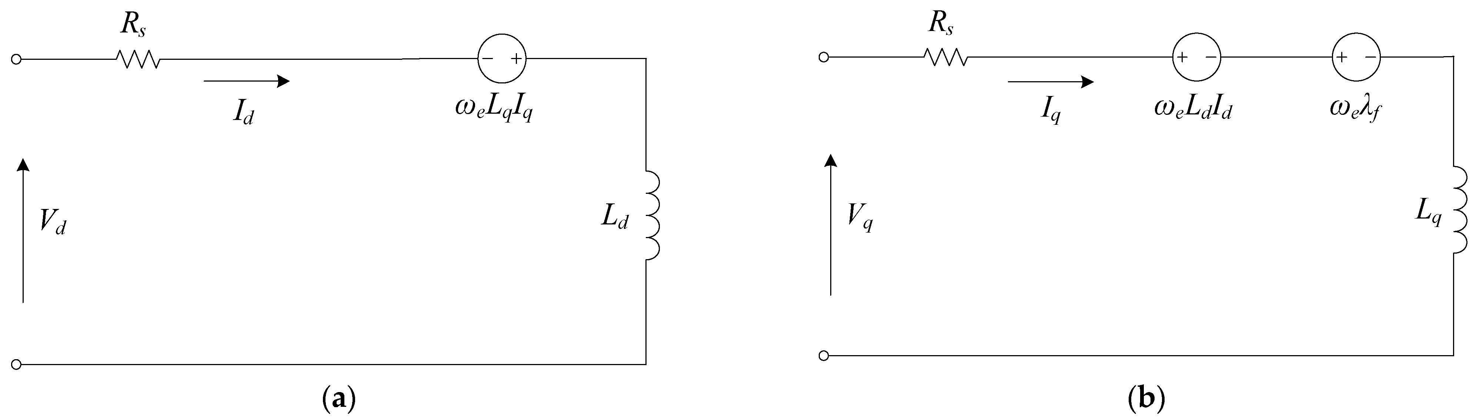
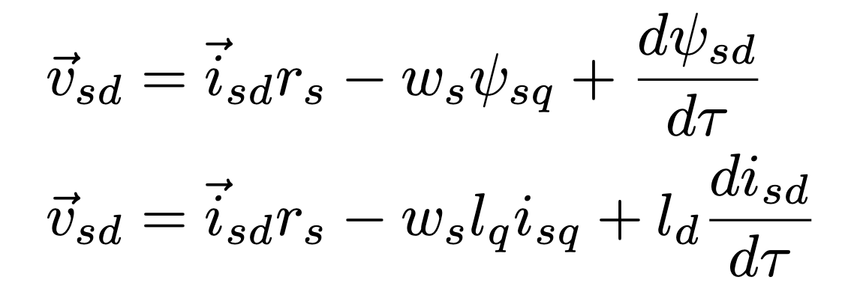
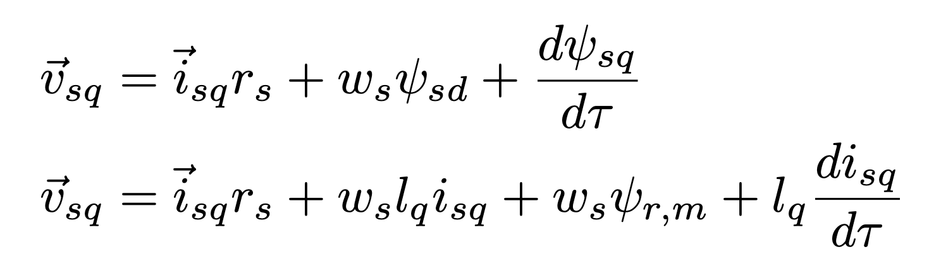
Mathematic model
We apply d-q axis coordinate model
The rotor lacks electromagnetic dynamics since the flux is generated by permanent magnets.
Equivalent circuit
Goals
Mathematic model
Dynamic simulation
PID Control
LQR Control
Comparation
Conclusion

Slide 3
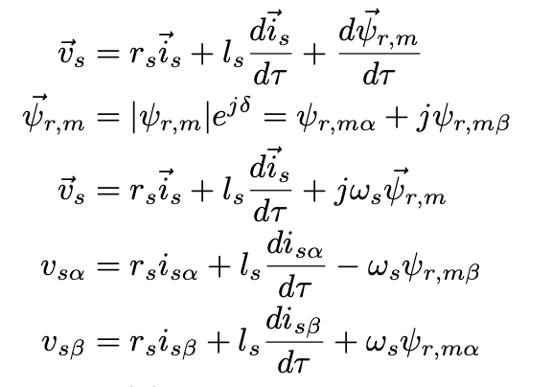
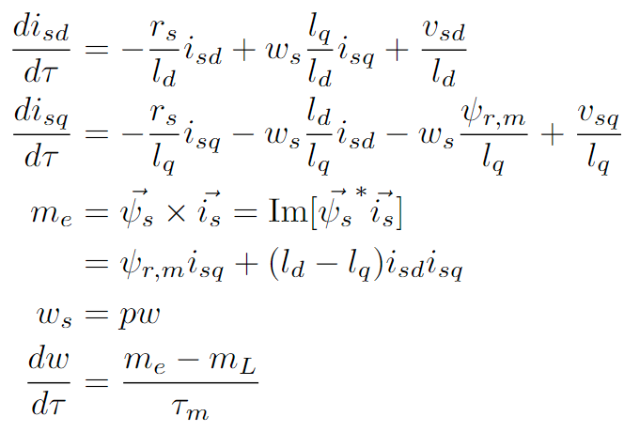
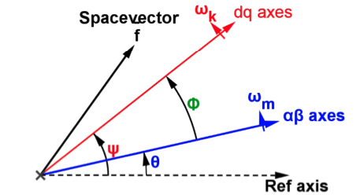
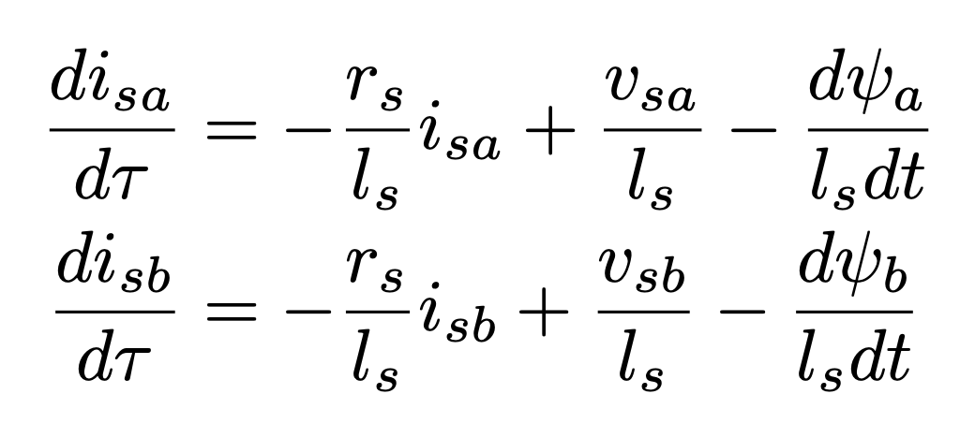
Mathematic model
d-q coordinate dynamic model is a commonly adopted and relatively straightforward.
In our efforts to gain a deeper understanding of the PMSM and help us study we tried to model in stator coordinates.
We can transform the equation on the d-q axis coordinate system to the α−β axis coordinate system using the rotation velocity relationship.
Therefore, the voltage equation in the α − β coordinate system can be expressed as
Goals
LQR Control
3
Mathematic model
Dynamic simulation
PID Control
Comparation
Conclusion

Slide 4
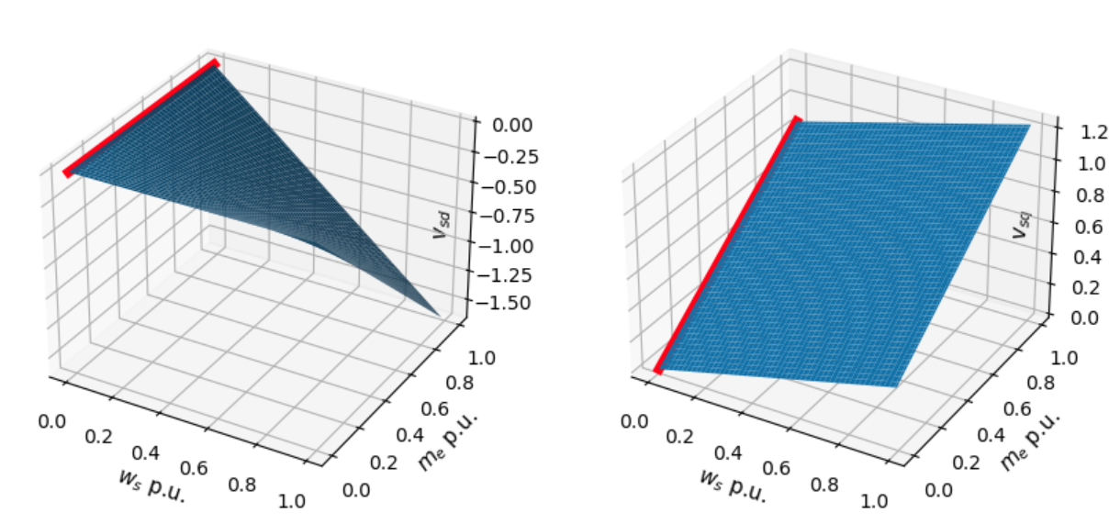
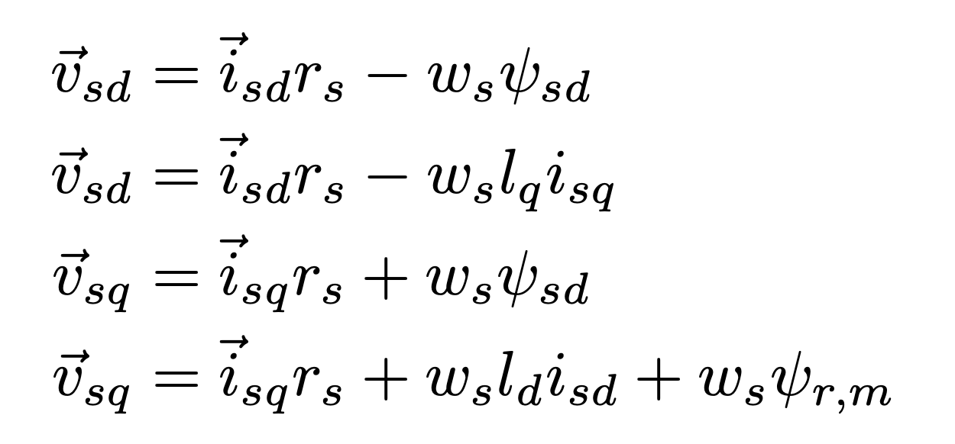
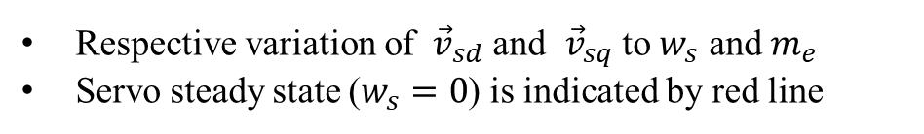
PMSM Steady State Model
In real practice, the motor almost work in steady state.
Hence, we need to keep torque output constant.
For steady state,
Respective variation of ${\vec{v}}_{sd}$ and ${\vec{v}}_{sq}$ to $w_{s}$ and $m_{e}$
Servo steady state ($w_{s}=0$) is indicated by red line
Goals
Mathematic model
Dynamic simulation
PID Control
LQR Control
Comparation
Conclusion

Slide 5
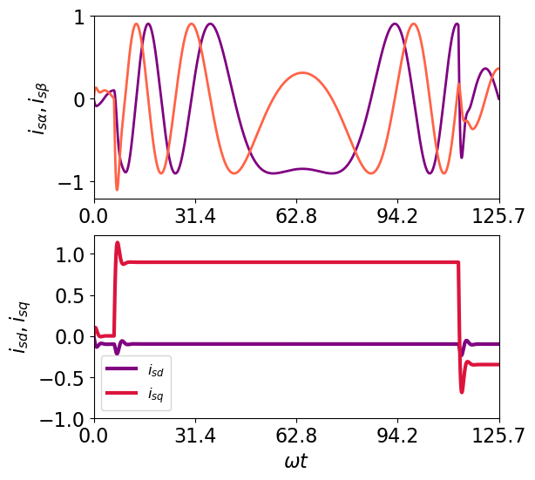
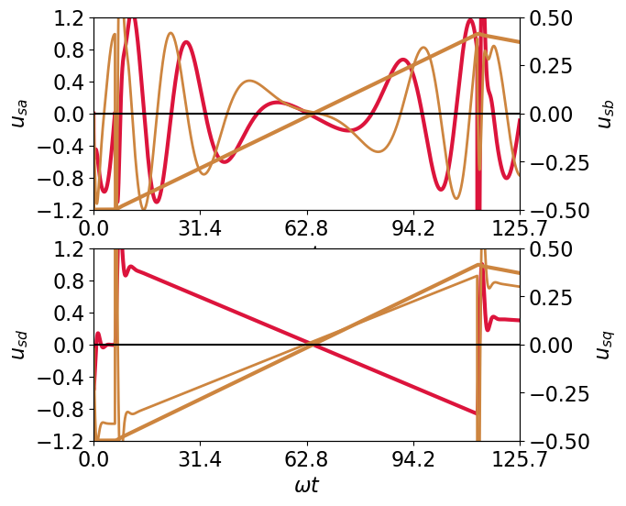
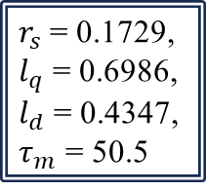
Dynamic simulation
Initial rotational velocity of -5 rad/s. Current $i_{q}$ to 0.8 then to -0.35.
$r_{s}$ = 0.1729,
$l_{q}$ = 0.6986,
$l_{d}$ = 0.4347,
$τ_{m}$ = 50.5
For both models we can see the the rotational speed initiates from -0.5 and progressively accelerates, reversing direction.
It also proves that the d-q coordinates method is much more straightforward for accomplishing precise current control compared with Stator coordinate model.
Goals
Mathematic model
Dynamic simulation
PID Control
LQR Control
Comparation
Conclusion

Slide 6
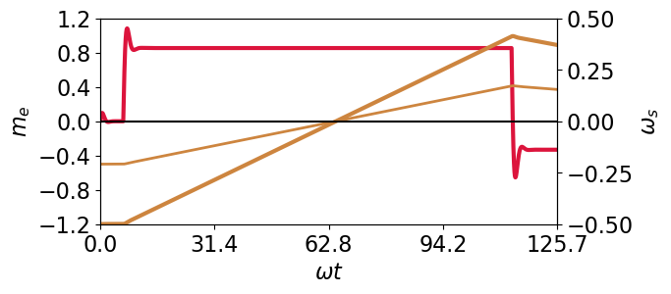
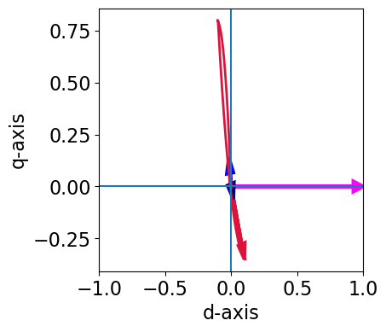
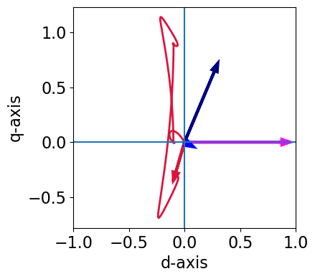
Dynamic simulation
Even though there is a smooth and slightly overshooting current initiation, the output torque and rotational speed exhibit seamless transitions without significant overshooting or oscillations.
For current trajectory the q-axis current undergoes significant changes, underscoring its primary role in torque control.
It demonstrates the q-axis current is the main contributor to torque regulation.
Goals
Mathematic model
Dynamic simulation
PID Control
LQR Control
Comparation
Conclusion

Slide 7
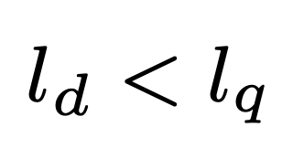
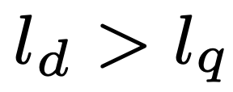
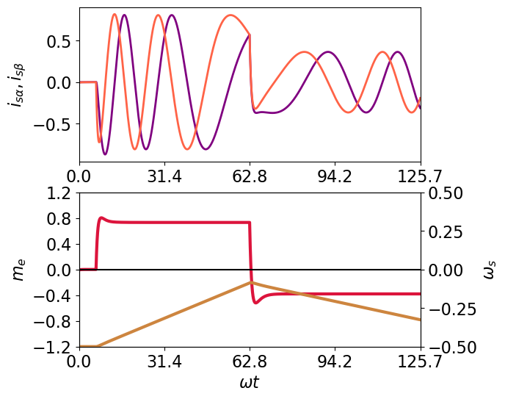
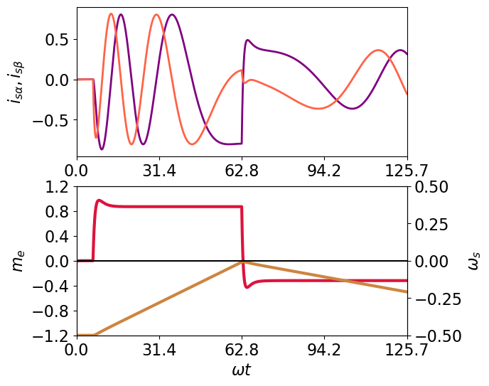
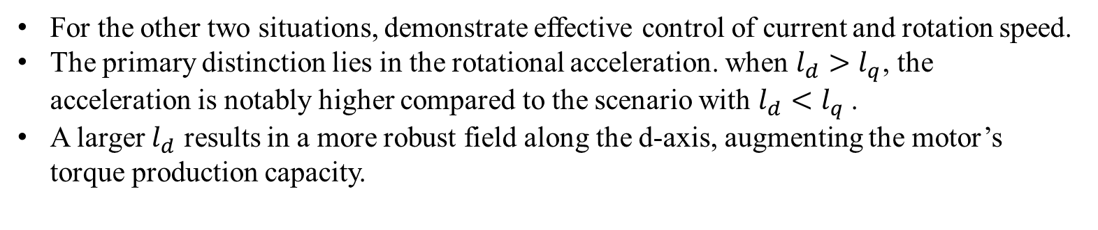
Dynamic simulation
For the other two situations, demonstrate effective control of current and rotation speed.
The primary distinction lies in the rotational acceleration. when $l_{d}>l_{q}$, the acceleration is notably higher compared to the scenario with $l_{d}<l_{q}$.
A larger $l_{d}$ results in a more robust field along the d-axis, augmenting the motor’s torque production capacity.
Goals
Mathematic model
Dynamic simulation
PID Control
LQR Control
Comparation
Conclusion

Slide 8
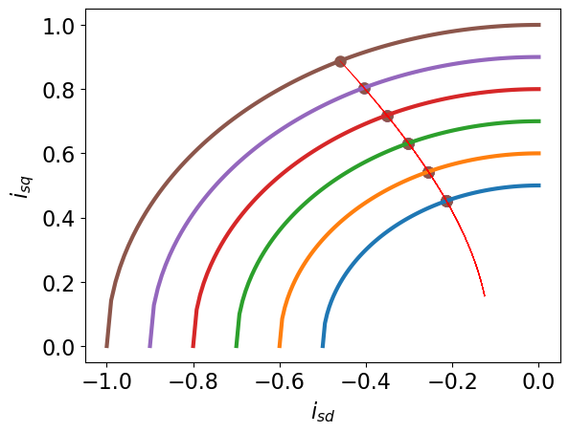
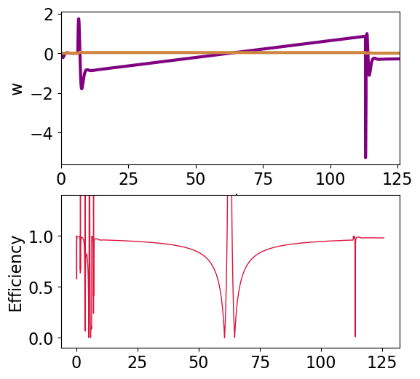
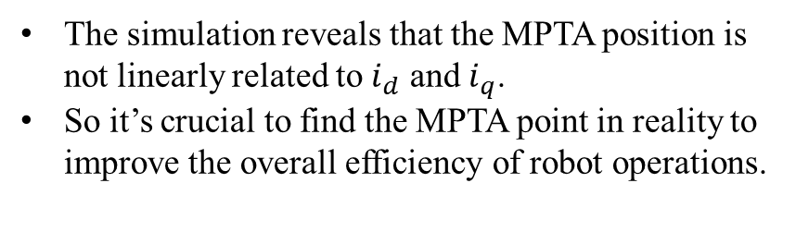
Mathematic model
Maximum Torque per Ampere(MPTA)
Power and efficiency
The simulation reveals that the MPTA position is not linearly related to $i_{d}$ and $i_{q}$.
So it’s crucial to find the MPTA point in reality to improve the overall efficiency of robot operations.
The efficiency remains consistently high, nearing 1 in most conditions.
However, fluctuations are observed when the current or rotor changes direction.
Goals
Mathematic model
Dynamic simulation
PID Control
LQR Control
Comparation
Conclusion

Slide 9
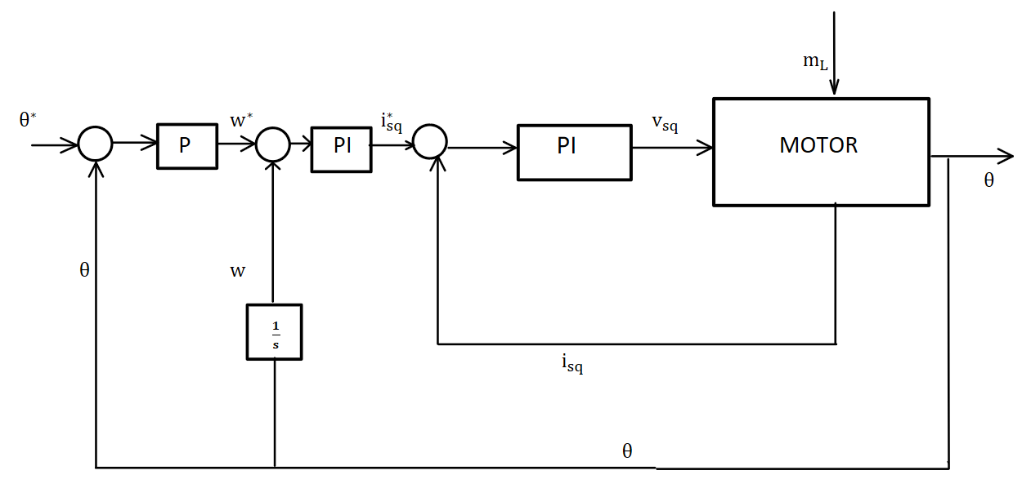
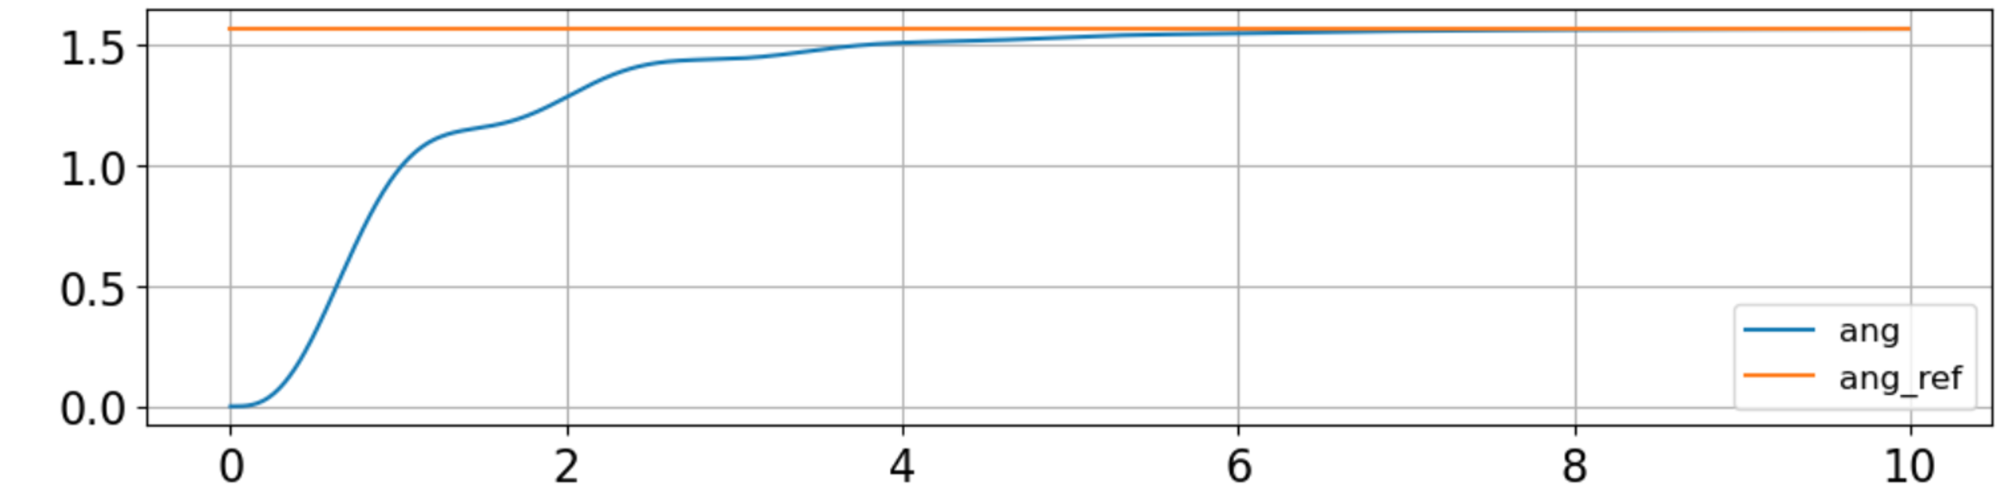
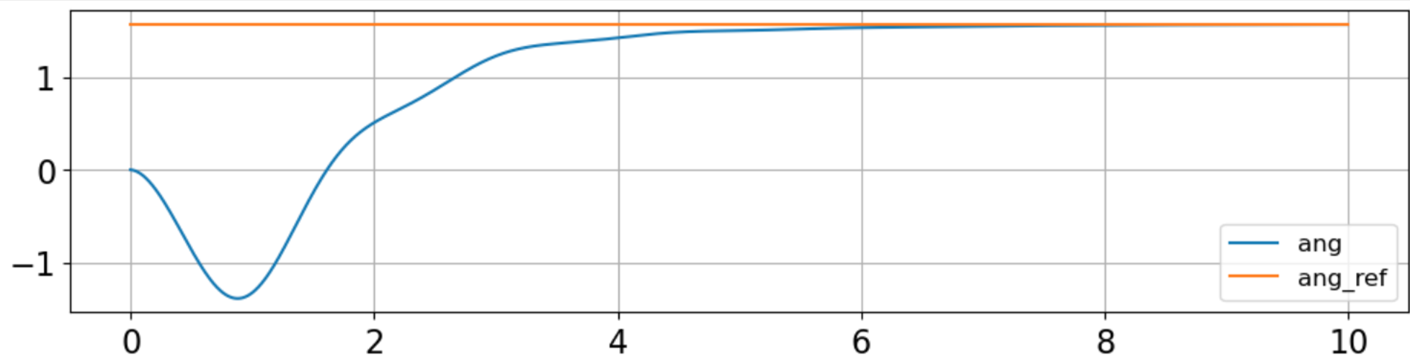
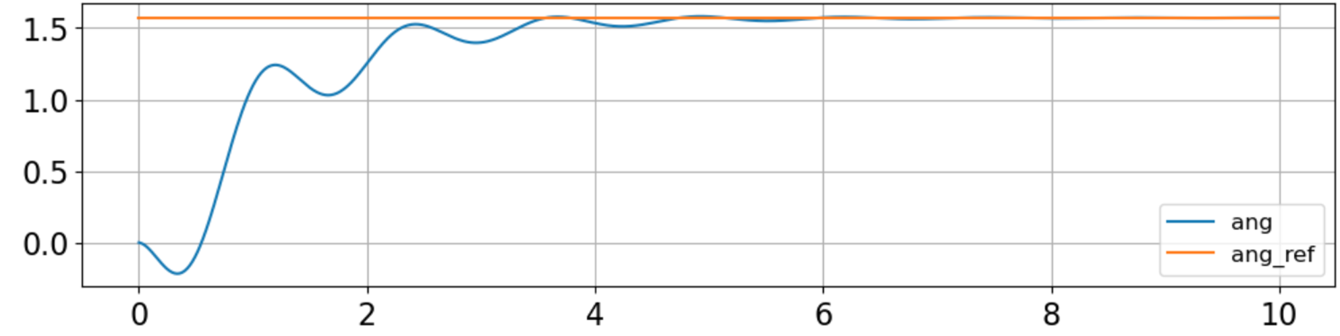
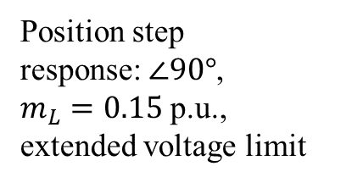
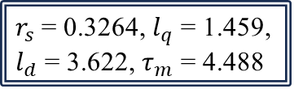
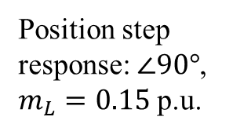
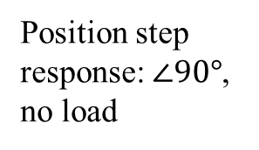
Cascade PID Control
Position step
response: $∠90°$,
no load
Angular position-velocity cascade control
Position step
response: $∠90°$,
$m_{L}=0.15$ p.u.
$r_{s}$ = 0.3264, $l_{q}$ = 1.459,
$l_{d}$ = 3.622, $τ_{m}$ = 4.488
Position step
response: $∠90°$,
$m_{L}=0.15$ p.u.,
extended voltage limit
No overshoot, but long settling time;
Slow recovery from load torque;
Less undershoot caused by load if voltage limit is extended to 5 p.u.;
Goals
Mathematic model
Dynamic simulation
PID Control
LQR Control
Comparation
Conclusion

Slide 10
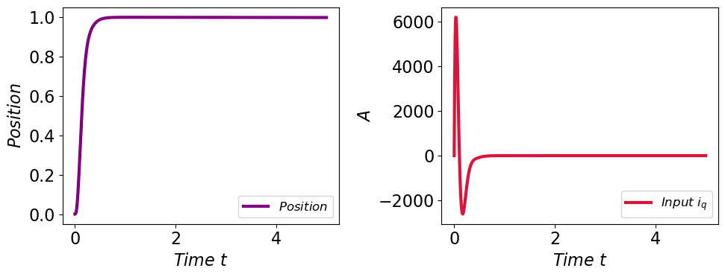
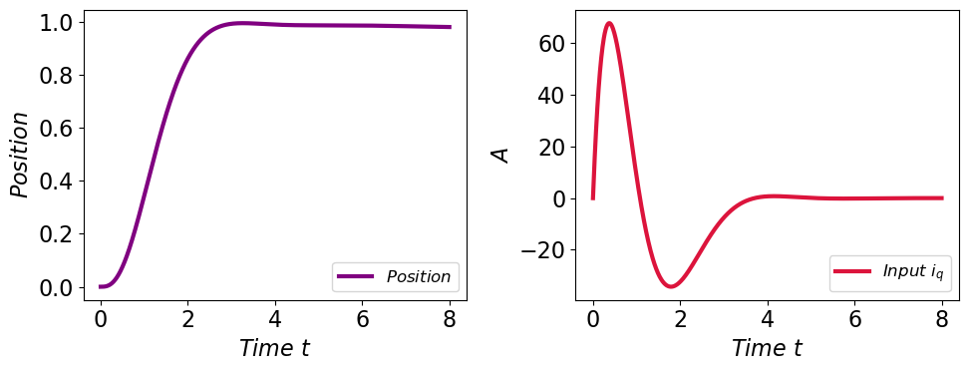
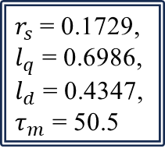
Augmented matrix LQR
$r_{s}$ = 0.1729,
$l_{q}$ = 0.6986,
$l_{d}$ = 0.4347,
$τ_{m}$ = 50.5
In order to get better performance of controller we applied augmented matrix control
The control result is ideal, fast response and precise position.
The control input signal requirement is too high to meet in reality.
Change to another pair of Q and R, the result is still good.
The input signal is reachable.
Goals
Mathematic model
Dynamic simulation
PID Control
LQR Control
Comparation
Conclusion

Slide 11
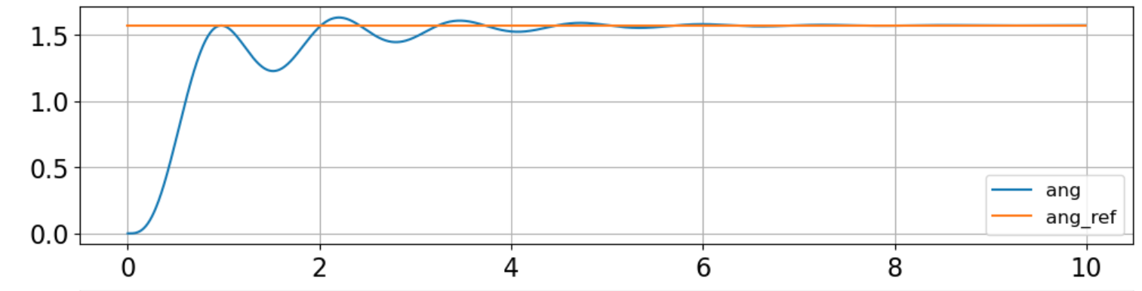
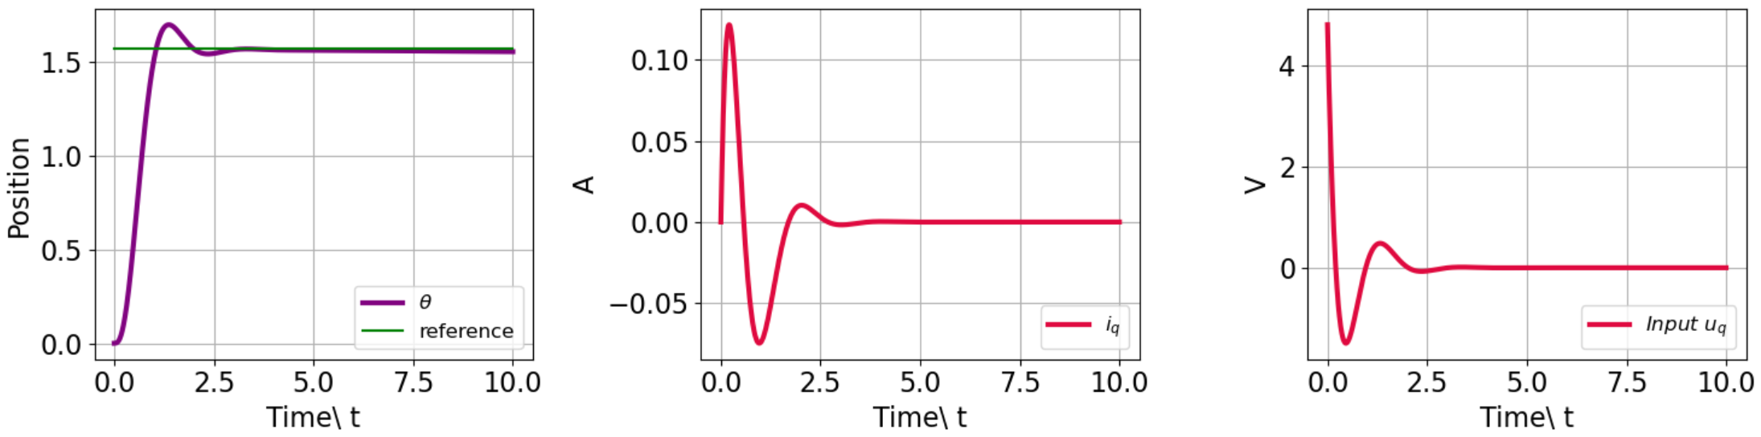

Comparation
$r_{s}$ = 0.3264, $l_{q}$ = 1.459,
$l_{d}$ = 3.622, $τ_{m}$ = 4.488
PID
LQR
Carefully tuned Q and R helps to overcome the problem of LQR control signal;
LQR performs much better than PID.
Goals
Mathematic model
Dynamic simulation
PID Control
LQR Control
Comparation
Conclusion

Slide 12
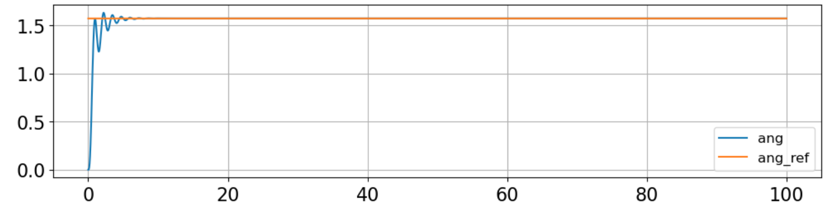
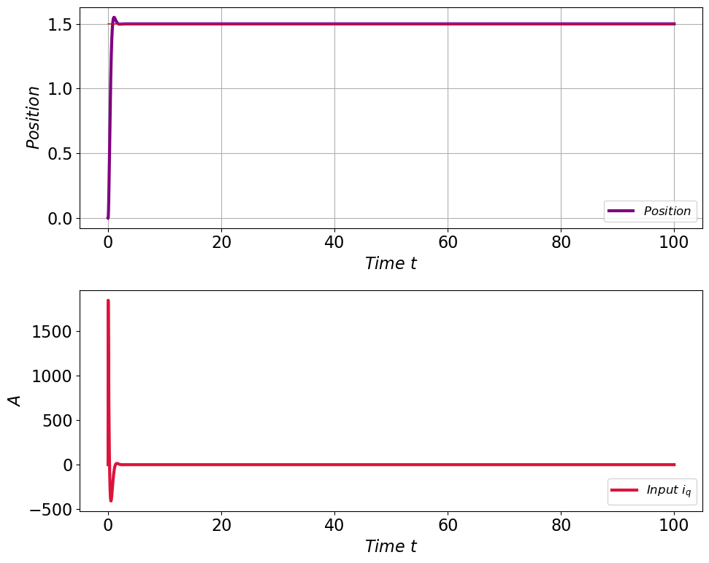
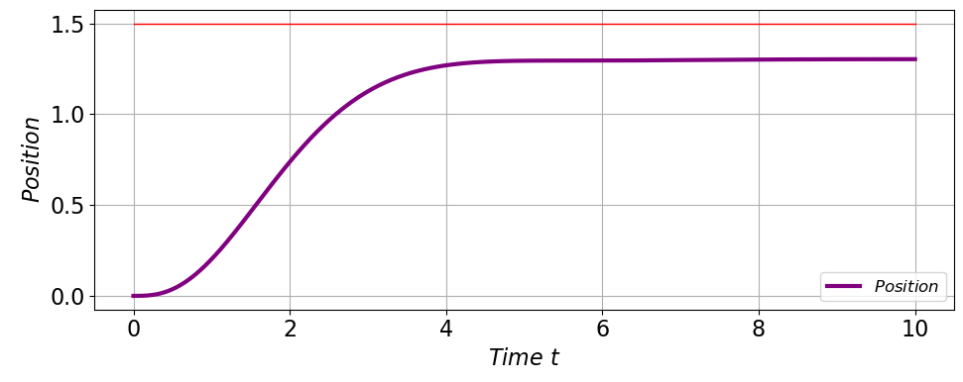
Comparation
PID
For long time simulation two methods
Still work well
LQR
LQR, disturbance
For LQR part, we try to build a disturbance reject system but not work well this can be the future research direction for us.
Goals
Mathematic model
Dynamic simulation
PID Control
LQR Control
Comparation
Conclusion

Slide 13
Conclusion
This project evaluates a PMSM for industrial robot position control, covering dynamic equations, steady-state analysis, and key motor characteristics.
The report compares position control using PID and LQR methods.
In the end we compared two position control PID and LQR and get the conclusion that LQR is a better choice for precise position control despite some unsolved defects.
Most importantly, these practice enhances our theoretical understanding learnt in class.
Goals
Mathematic model
Dynamic simulation
PID Control
LQR Control
Comparation
Conclusion

